Slide 1
Characterization and Optimization of Cache Behavior
Kristof Beyls, Yijun Yu, Erik D’Hollander
http://winpar.elis.rug.ac.be/ppt
Electronics and Information Systems
Gent University, Belgium
Notes:
Good afternoon, My name is Kristof Beyls. I’m a PhD student at the University of Ghent,
and my advisor is Prof. Erik. D’Hollander. The next hour I want to talk to you about our work on the characterization and optimization of cache behavior.

Slide 2
Presentation overview
Part 1: Reuse distance as a metric for cache behavior
  How accurate is reuse distance in predicting cache behavior?
  How effective are compilers in removing cache misses?
Part 2: Program-centric visualization of data locality
  Reuse distance-based visualization
  Pattern-based visualization
Part 3: Cache remapping: eliminating cache conflicts in tiled codes
Notes:
This talk consists of 3 parts, which will all take about the same amount of time.
In part 1, I’ll talk about the reuse distance as a metric for cache behavior. In that part it will be shown that capacity misses dominate and that they need to be eliminated at higher semantic levels such as the compiler level or the algorithmic level.
In part 2, I’ll talk about program-centric visualization of data locality. Two views have been developed: a pattern-based view and a reuse distance-based view.
In part 3, Cache remapping will be discussed. It is a compile-time technique which eliminates conflicts in tiled algorithms.

Slide 3
Part 1: Introduction to the Reuse Distance
(PDCS01)
Notes:
It’s time for part 1 about the reuse distance.

Slide 4
Overview reuse distance
Introduction
Reuse distance ↔ cache behavior
Effect of compiler optimization
Capacity miss reduction techniques
Summary
Notes:
First, I’ll give an introduction,
After which I’ll define the reuse distance and give some theoretical background about its relation to cache behavior
After that, I’ll show you the effect of current state-of-the-art compiler optimization on the reuse distance and on
the cache behavior.
I’ll shortly review a number of techniques to reduce the reuse distance,
After which a conclusion follows.

Slide 5
Overview reuse distance
Introduction
Reuse distance ↔ cache behavior
Effect of compiler optimization
Capacity miss reduction techniques
Summary

Slide 6
1. Introduction
Gap between processor and memory speed widens exponentially fast
  Typical: 1 memory access = 100 processor cycles
Caches can deliver data more quickly, but have limited capacity
Reuse distance is a metric for a programs cache performance
Notes:
As a result of Moore’s law, the gap between processor speed and memory speed doubles every 2 years. The processor speed increases by 60% per year, memory speed increases by about 7% per year. On current workstations, the latency of a memory access takes as much time as 100 processor cycles.
To hide the slowness of the main memory, caches are used. Caches are fast but small memories between the processor and the main memory. In order to achieve high performance, data should be found in the cache most of the time. However, because of the limited capacity of the cache, cache misses occur.
The reuse distance is a metric for the cache behavior of programs. A large reuse distance will indicate a high probability of cache misses.

Slide 7
Overview reuse distance
Introduction
Reuse distance ↔ cache behavior
Effect of compiler optimization
Capacity miss reduction techniques
Summary

Slide 8
2.a Reuse distance
Definition: The reuse distance of a memory access is the number of unique addresses referenced since the last access to the requested data.
address | A | B | C | A | B | B | A | C
distance | ∞ | ∞ | ∞ | 2 | 2 | 0 | 1 | 2
Notes:
The reuse distance has the following definition: the reuse distance of an access is the number of unique addresses accessed since the last reference to the requested data.
As an illustration, consider the reference trace ABCABBAC. For the first references, the reuse distance is
infinity, since the address was not previously referenced. For the second reference to A, the reuse distance is 2 since 2 unique addresses have been referenced since the previous access to A. …

Slide 9
2.b Reuse distance and fully associative cache
Property: In a fully associative LRU cache with n cache lines, a reference will hit if the reuse distance d<n.
Corollary: In any cache with n lines, a cache miss with reuse distance d is:
d < n | Conflict miss
n ≤ d < ∞ | Capacity miss
d = ∞ | Cold miss
Notes:
The reuse distance has the following interesting and important property:
For a fully associative cache with the Least Recently Used policy, a reference is a cache hit if its reuse distance is smaller than the number of cache lines. If the reuse distance is larger than the number of cache lines, it results in a miss.
As a corollary of this property, a miss in any kind of cache structure is:
a conflict miss if the reuse distance is smaller than the number of cache lines
A capacity miss if the reuse distance is larger than the number of cache lines
A cold miss if the reuse distance is infinite

Slide 10
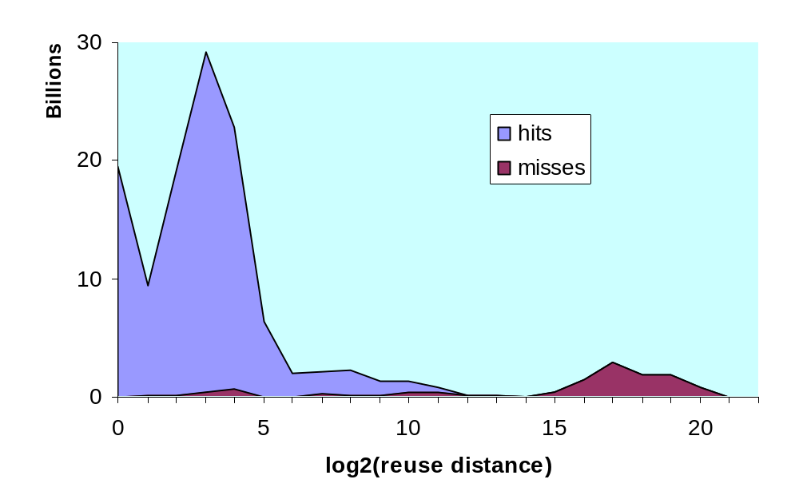
2.c Reuse Distance Distribution Spec95fp
Notes:
Here you see the distribution of the reuse distance for all the references in the SPEC95 floating point benchmark,
On the X-axis you see the reuse distance in log-scale. On the Y-axis, you see the number of reference , expressed in billions. It is clear that most reference occur at short reuse distance and that they hit the cache.
This plot shows the probability of hitting the cache at a certain reuse distance for the SPECfp95 benchmark. To obtain these results, the benchmarks have been instrumented using the SUIF-compiler and the reuse distance was measured.

Slide 11
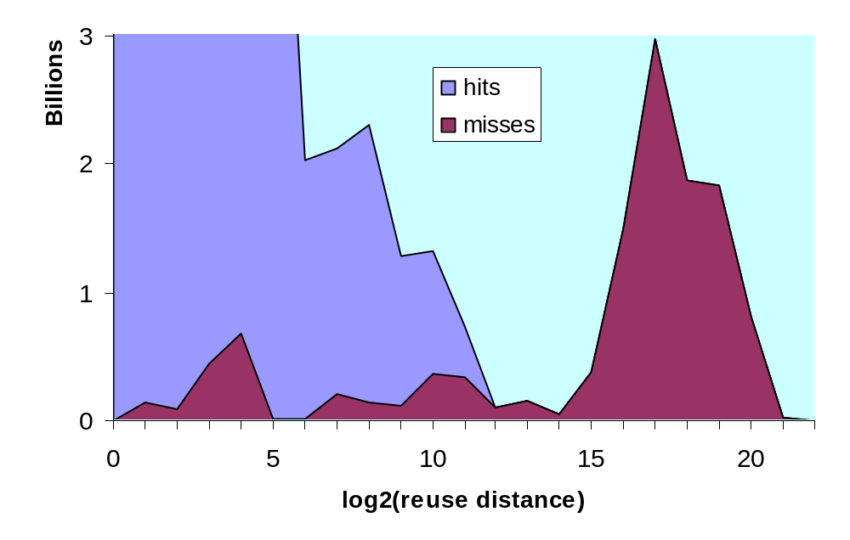
2.d Classifying cache misses for SPEC95fp
Conflict
Capacity
Cache size
Notes:
However, if we zoom in on the cache misses, we see that most of the misses occur at large reuse distance. The simulated cache is 32KB direct mapped with 32byte line size, so there are 1024 cache lines. As a consequence, the misses to the left of the cache capacity are conflict misses, the misses to the right are capacity misses. The number of cold misses is negligibly small.
We can also see in this plot, that when the reuse distance is larger than the cache capacity, the probability of a cache miss increases dramatically.

Slide 12
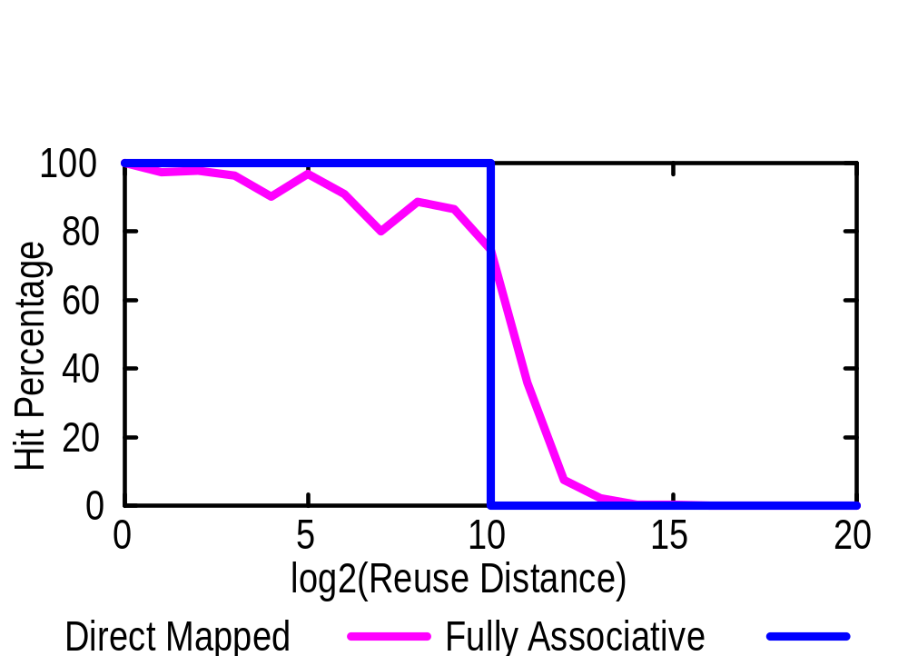
2.e Reuse distance vs. hit probability
Notes:
So for a fully associative cache, the preceding lemma states that the reuse distance exactly determines the cache behavior. In a direct mapped cache, conflicts are expected and data can be thrown out of the cache after they reside there for only a short time.
However, when we look at this plot we see that the reuse distance is a good predictor for the cache behavior, even for a direct mapped cache: for references with a reuse distance smaller than the cache, the probability is high for hitting the cache; for references with a reuse distance larger than the cache size, the probability is low for hitting the cache.

Slide 13
Overview reuse distance
Introduction
Reuse distance ↔ cache behavior
Effect of compiler optimization
Capacity miss reduction techniques
Summary

Slide 14
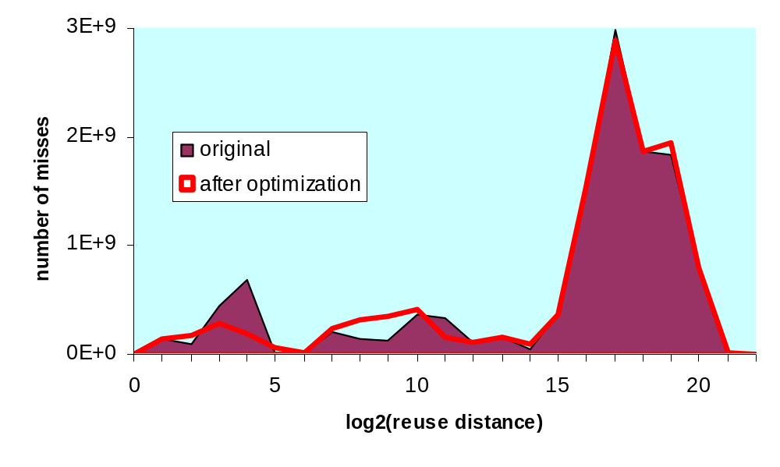
3.a Reuse distance after optimization
Conflict
Capacity
Notes:
We used the state-of-the-art optimizing SGI Pro64 compiler to measure the effectiveness of compiler optimizations
on cache behavior. In this plot we can see that the number of conflict misses are reduced, but the number of
capacity misses is hardly reduced. The compiler has quite a lot of influence on short reuse distance, but for long reuse distance, hardly anything changes.

Slide 15
3.b Effect of compiler optimization
SGIpro compiler for Itanium
30% of conflict misses are removed,
1% of capacity misses are removed.
Conclusion: much work needs to be done to remove the most important kind of cache misses: capacity misses.
Notes:
30% of the conflict misses were reduced, and only 1% of the capacity misses.
This leads to the conclusion that the dominating kind of misses, the capacity misses, are only very minimally reduced. Much work needs to be done in compilers to eliminate capacity misses.

Slide 16
Overview reuse distance
Introduction
Reuse distance ↔ cache behavior
Effect of compiler optimization
Capacity miss reduction techniques
Summary

Slide 17
4. Capacity miss reduction
Reuse distance must be smaller than cache size
Hardware level
  Increasing cache size
CS
CS
CS
CS
CS
CS
CS
Compiler level
  Loop tiling
  Loop fusion
Algorithmic level
Notes:
Since most of the cache misses are capacity misses, we’ll review the most important techniques to decrease them. To eliminate the capacity miss, the reuse distance must be made smaller than the cache size.
On the hardware level, this can be done by increasing the cache size. As a result, probability of hitting the cache will increase for the reference with a long reuse distance.
On the compiler and algorithmic level, the cache size cannot be changed, but the program or the algorithm can be changed, so that fewer long reuses occur. On the compiler level, the most well-known techniques are loop tiling and loop fusion.

Slide 18
4.a Algorithmic level
Programmer has a better understanding of the global program structure.
Programmer can change algorithm, so that long distance reuses decrease.
Visualization of the long reuse distances can help the programmer to identify poor data locality in the code.
Notes:
At the algorithmic level, one has more freedom to restructure the program than at the compiler level. Also the programmer has a better understanding of the global program structure. Therefore, the programmer can decide to use different algorithms to decrease long reuse distances.
However for it is difficult to know exactly where in the code the bad data locality happens, and instrumentation and visualization of the program can help the programmer to pinpoint the hot spots.

Slide 19
Overview reuse distance
Introduction
Reuse distance ↔ cache behavior
Effect of compiler optimization
Capacity miss reduction techniques
Summary

Slide 20
5. What did we learn?
Reuse distance predicts cache behavior accurately, even for direct mapped caches.
Compiler optimizations for eliminating capacity misses are currently not powerful enough. A large overview over the code is needed.
Programmer has large overview of code. Reuse distance visualization can help the programmer to identify regions with poor locality.
Notes:
The reuse distance predicts cache behavior accurately, even for low-associative caches such as direct mapped caches.
The compiler optimizations for eliminating capacity misses are currently not powerful enough. It is harder to eliminate capacity misses than conflict misses, since a larger overview over the code is needed.
The programmer has this large overview over the code, so if he knows what causes the bad data locality in his code, he can resolve them best.

Slide 21
Part 2: Program-Centric Visualization of Data Locality
(IV2001)
Notes:
Now lets go to part 2, the program-centric visualization of data locality.

Slide 22

Background
A program uses the
cache transparently. The
data locality is obscure
to the programmer without
by cache lines: What happens in the cache?
e.g. CVT, Rivet
by references: What happens to the program?
- Reuse distance-based visualization
- Pattern-based visualization
Notes:
A program make uses of the cache implicitly, but the programmer may not aware of what’s going on with the data locality, unless one can see what happens. The visualization!
Earlier work visualized the cache lines, showing what happens in the cache. E.g. CVT, Rivet, Vtune?
In this work, we choose for a program-centric approach, showing what happens to the program. This
is done by showing the miss distribution, reuse distance histograms etcetera.

Slide 23
Reuse distance-based Visualization
What is the source of the capacity misses in my code?
Notes:
Now let me show you the reuse-distance based visualization

Slide 24
Instrumentation
Programs are instrumented to obtain the following data:
  Reuse distance distribution for every static array reference
    It indicates the cache behavior of the reference
  For every static reference, the previous accesses to the same data is stored.
    It can show the programmer where the previous accesses occurred for long distance reuses.
Notes:
To obtain the necessary data, the programs are instrumented and executed. The reuse distance distribution for every array reference is recorded. For every static reference, the previous accesses to the same data are remembered.

Slide 25
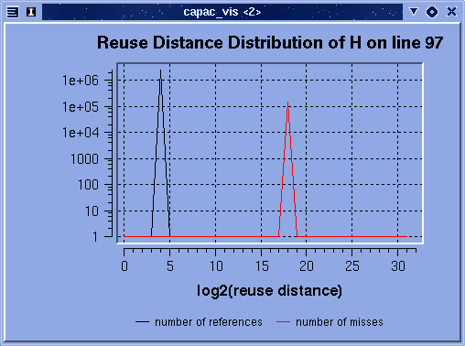
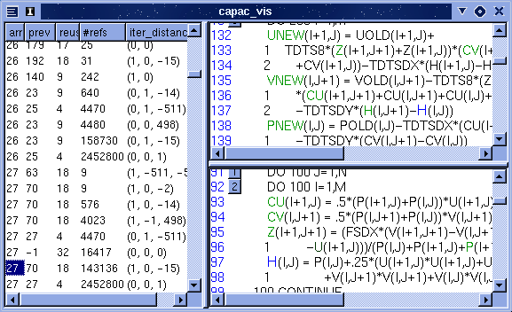
Main view on SWIM
2¹⁸ cache lines =
2¹⁸ * 64 bytes =
16 Mbyte cache
is needed to capture reuse
H(i,j)
(1,0,-15)
(0,0,1)
HIT
MISS
18
(1,0,-15)
H(i,j)
4
(0,0,1)
Notes:
This is the main view on the program. On the right, you see 2 windows, containing the same program source text. On the right, you see a table with data. In the first column of this table is the number of the current array reference, in the second column is the number of the reference which previously accessed the same data. In the third column, one can see the logarithm of the reuse distance. For example, here we have a reuse distance of 2 to the power 18 cache lines, where each cache line contains 64 bytes. This means that the cache needs to be 16 Mbytes before the reuse is captured by the cache.
If you click on this line, the view will show you the access under consideration in the lower right window, and the access that previously accessed the same data in the upper right window.
In the last column, the iteration space distance between the current use and the previous reuse is shown. For this example it is 1 0 –15, which means that the reuse happens between consecutive iterations of the outermost loop. The distance –15 is caused by the fact that a cache line contains 16 consecutive array elements.
If you click a reference, a window pops up which shows you the reuse distance distribution of that reference. For this reference, one can see that 1 in 16 times in has a long reuse distance and 15 times out of 16 it has a small reuse distance. The small reuse distance is caused by the spatial locality and the fact that 16 data elements fit in a single cache line. Once every 16 innermost iterations, a new cache line needs to be fetched. This cache line was used long before (reuse distance of 2¹⁸).

Slide 26
How to optimize locality in SWIM
Reuse between iterations
of the outer loop (1,0,-15):
tiling is needed
but: non-perfectly nested loop
so: tiling needs to be extend
e.g. Song&Li, PLDI99:
extending tiling for this kind of
program structure:
52% speedup, because of
increased temporal reuse
DO ncycle=1,itmax
do 10 i
do 10 j
10 s1(i,j)
s2
do 20 i
do 20 j
20 s3(i,j)
...
ENDDO
Notes:
The SWIM program has a program structure as shown on the left: an outermost time-step loop with in it a number of loop nests.
From the visualizer, we learned that reuse occurs between iterations of the outermost loop. So, intuitively, we feel like some kind of tiling is needed to shorten the distance of reuses at the outermost loop level. However, loop tiling is traditionally only defined for perfect nested loops. So tiling needs to be extended. As an indication that tiling can be extended to handle this kind of code structures, we refer to the work be Song and Li, as described in their PLDI99 paper “New tiling techniques to improve cache temporal locality”. They found to be able to obtain a 52% speedup for this program on a machine with a 2MB L2 cache.

Slide 27
Reuse-distance based visualization enables:
The tool shows the place and the reason for poor data locality in the program.
Visualization of reuse distances in the code enables recognizing code patterns leading to capacity misses.
Compiler writer can use the tool to think about new effective program optimizations for data locality.
Notes:
This tool shows the place and the reason for poor data locality in the program.
The visualization leads to recognizing the code patterns which lead to the capacity misses in the program.
A programmer can use this tool to optimize its program. Also, a compiler writer can use this tool to think about new and effective program optimizations to reduce the reuse distance.

Slide 28
Pattern-based Visualization
Show me the cache behavior of my program!
Notes:
Good morning. My topic is on visualizing the cache behavior of a program execution. Believe your eyes!

Slide 29
Views of the cache behavior
Cache misses
  Cache hits and misses
  Compulsory, capacity and conflict misses
  Horizontally wrap-around of millions of pixels will make periodical patterns visible
Histograms
  Reuse distances
  Cache misses
  Distribution of
  arrays and linenos
Notes:
In this visualization, three views are presented. First view uses pixels to present cache hit and misses in colors. A hit reference is white, a compulsory miss is blue, means the reference brought into the cache for first time; a green pixel stands for a capacity miss, means the cache size is not large enough to cover the reuse distance; the conflict miss is in red, means the cache set is not large enough to hold all the references mapped to the same set.
The second view presents the reuse distance, the distinct cache lines between reused references as fully associative reuse distance and set associative reuse distance. They reveals the reason for a cache miss.
The last view is histograms for reuse distances and cache misses. They are distributed along different arrays and line numbers. This enable the programmer to go back to his code.

Slide 30
Experiments
Matrix multiplication
Tiled matrix multiplication
TOMCATV (SPECfp95)
FFT
Notes:
Having the patterns fresh in mind, lets come to several real examples. Haven’t you heard of Matrix multiplication or Fast Fourier transformation? The TOMCATV example is a benchmark program taken from SPEC benchmarks.

Slide 31
Matrix multiplication
#define N 40
for (i=0;i<N;i++)
for (j=0;j<N;j++) {
c[i][j] = 0;
for (k=0;k<N;k++) c[i][j] += a[i][k] * b[k][j];
}
Notes:
Matrix multiplication. The size of matrix is 40 by 40. Not so large, but already a disaster to our poor small 1 KB cache. We will see this in view of cache miss, reuse distance and histograms next.

Slide 32
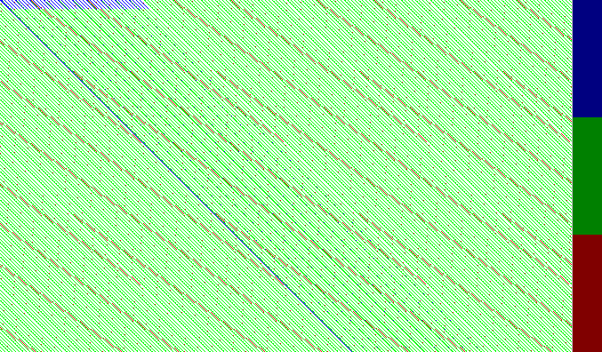
MM Cache miss patterns
Notes:
The cache misses patterns. The colored pixels mostly are green, suggesting capacity misses. Conflict and compulsory misses are not so common.

Slide 33
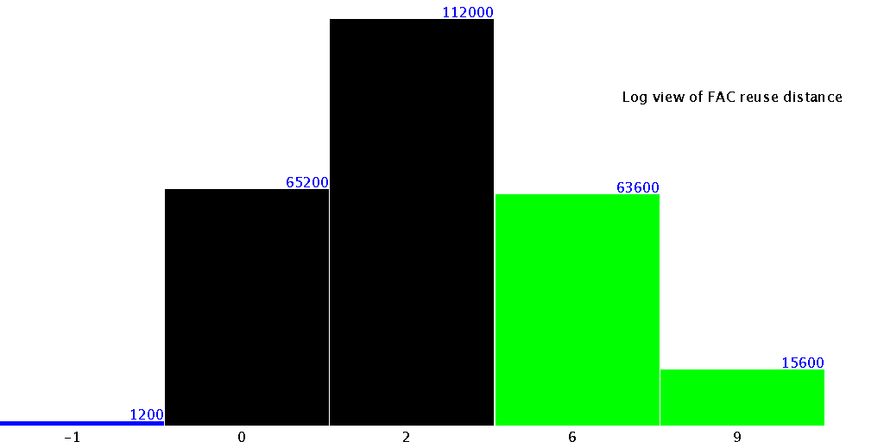
MM Histogram of reuse distance
Cold miss
Capacity miss
Notes:
The histogram view of fully associative reuse distances. The cold miss happens because they are the first accesses references. The capacity misses happen because the reuse distance is larger than the 32 cache lines, which is 2 to the power of 5. The rest in the middle are all hits.

Slide 34
Tiled matrix multiplication
B*B+B+1<1024/8
1<B<12
#define N 40
#define B 5
double a[N][N],b[N][N],c[N][N];
for (i_0=0;i_0<N; i_0+=B)
for (j_0=0;j_0<N; j_0+=B) {
for (i=i_0; i<min(i_0+B,N); i++)
for (j=j_0; j<min(j_0+B,N); j++)
c[i][j]=0.0;
for (k_0=0;k_0<N; k_0+=B)
for (i=i_0; i<min(i_0+B,N); i++)
for (j=j_0; j<min(j_0+B,N); j++)
for (k=k_0; k<min(k_0+B,N); k++)
c[i][j] += a[i][k] * b[k][j];
}
Notes:
Loop tiling is the well-known approach to reduce capacity misses. The idea is to calculate sub-matrix B by B size multiplication that completely fits in the cache. Here we take B as 5.

Slide 35

TMM: Fewer cap, more conf
Notes:
What happens to the program execution? You don’t see many green pixels, however, there are more red pixels.

Slide 36
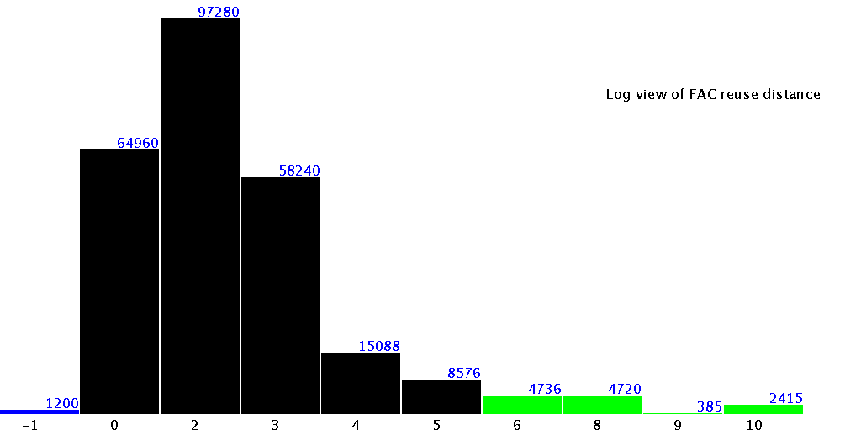
TMM: Fewer long reuse distances
Cold
miss
Capacity miss
Notes:
The histogram of FAC reuse distances shows much fewer references have reuse distances longer than 32.

Slide 37
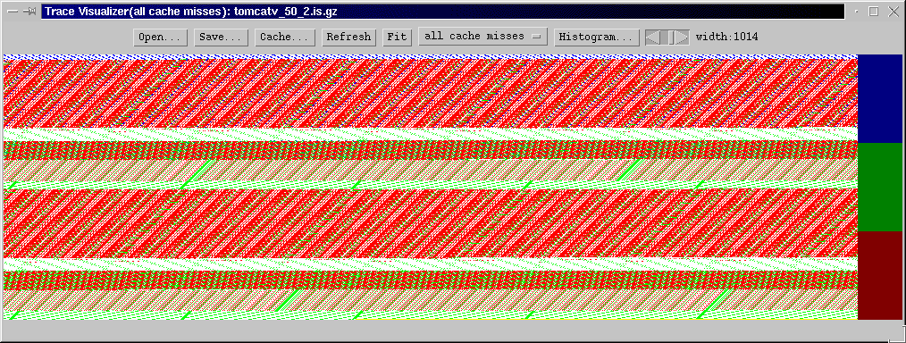
TOMCATV
histogram
Notes:
Now let’s use TOMCATV to explain the technique towards reducing conflict misses. The cache misses view of the TOMCATV program shows clearly 5 patterns each corresponding to a loop. These patterns repeat themselves by the outermost iterations. At least two of the five strips are red, suffers a lot from conflict misses.

Slide 38
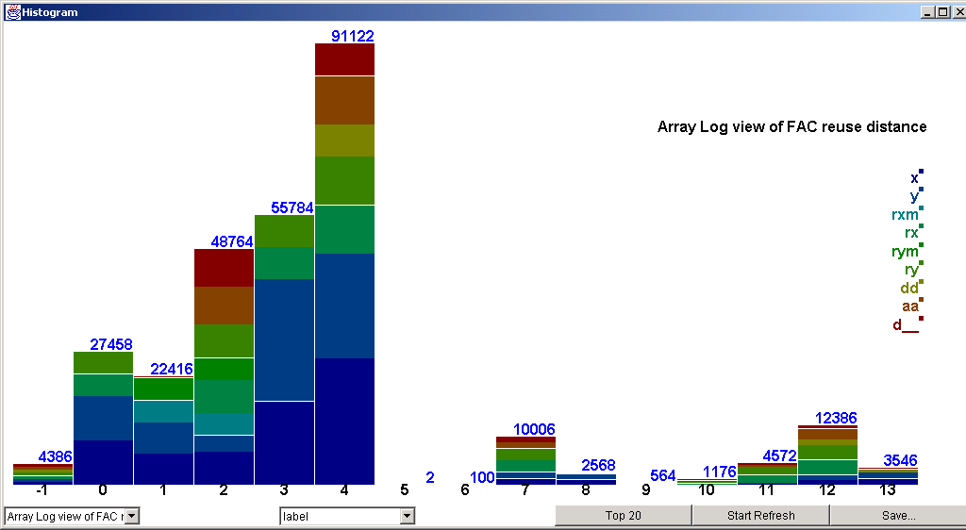
TOMCATV: Histogram with arrays
Cold
miss
Capacity miss
Notes:
The FAC reuse distance histogram distributed over different arrays shows not very much references have longer reuse distances. The bottleneck now are the conflict misses.

Slide 39
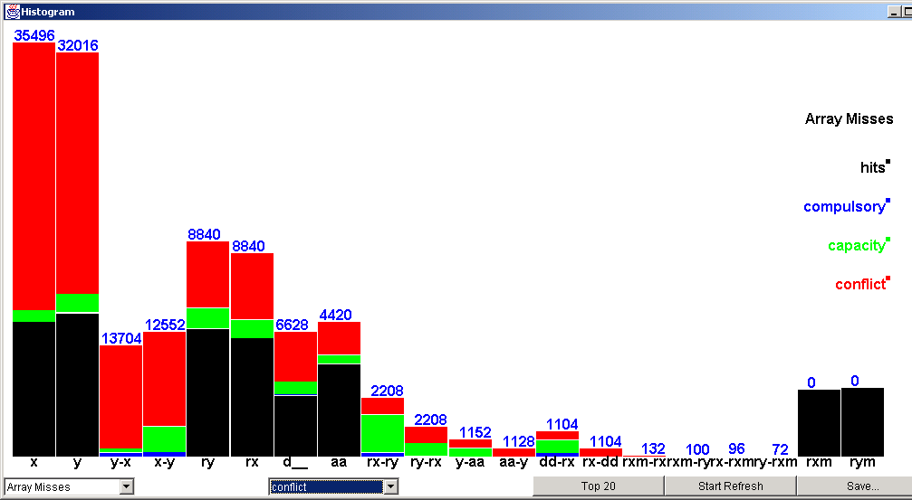
TOMCATV: Conflict misses with arrays
Hits
Top 20
Notes:
In the histogram view of misses distributed over different arrays, we can pick the top 20 array-pairs that have the most conflict misses. The hits are in black. The height of the red bars decreases from left to right. The label with single name is self-conflict and the label with two hyphened names is group-conflicts.

Slide 40
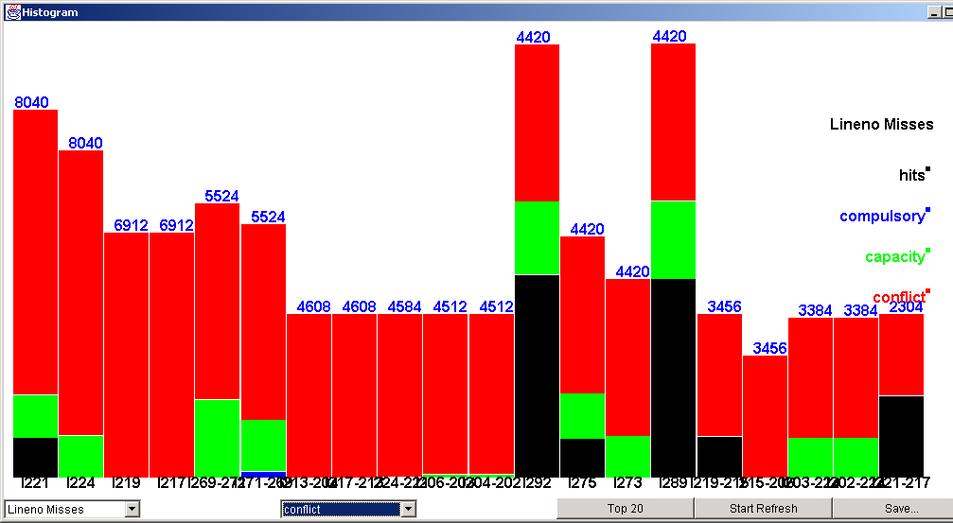
TOMCATV: Conflict misses with linenos
Notes:
Furthermore, we can also display the misses distributed along different line numbers. Sorting them and show the top 20. It’s clear that lines from 217 to 224 requires special attention.

Slide 41
TOMCATV: Back to the source code
for (j = 2; j < n; ++j) {
for (i = 2; i < n; ++i) {
…
217 pyy = x[i + (j + 1) * 513 - 514] - x[i + j * 513 - 514] *
2. + x[i + (j - 1) * 513 - 514];
219 qyy = y[i + (j + 1) * 513 - 514] - y[i + j * 513 - 514] *
2. + y[i + (j - 1) * 513 - 514];
221 pxy = x[i + 1 + (j + 1) * 513 - 514] - x[i + 1 + (j- 1) *
513 - 514] - x[i - 1 + (j + 1) * 513 - 514] + x[
i - 1 + (j - 1) * 513 - 514];
224 qxy = y[i + 1 + (j + 1) * 513 - 514] - y[i + 1 + (j- 1) *
513 - 514] - y[i - 1 + (j + 1) * 513 - 514] + y[
i - 1 + (j - 1) * 513 - 514];
…
}
524
(i + (j + 1) * 513 – 514)*8/32
= (i + j * 513 – 514)*8/32 mod (1024/32)
Notes:
Go back to the source code, which is the C program generated from the Fortran code by f2c. The line numbers from 217 to 224 lies in a double loop. The array subscripts used in line 217 for example, shows self-conflict. Because the factor 513 is close the power of 2, the two references map to the same cache line. This conflicts the direct-mapped cache. If we change array size as 524. What will happen?

Slide 42
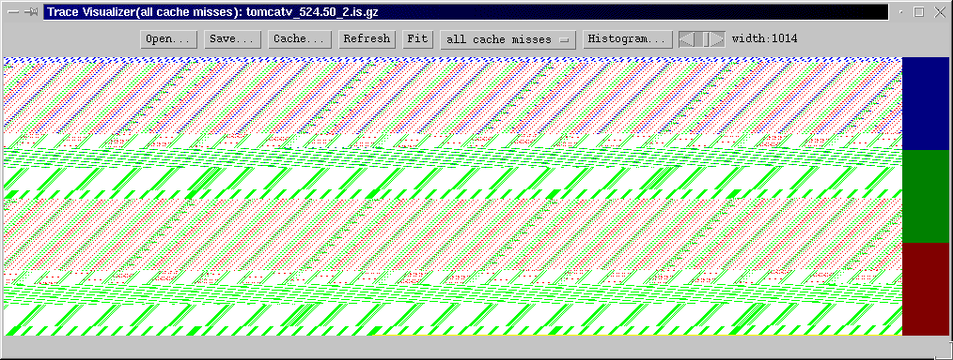
TOMCATV: After array alignment
Changing array size from 513 to 524 leads to about 50% speedup of TOMCATV on real input set on Pentium III.
Notes:
Almost no red in the view now.

Slide 43
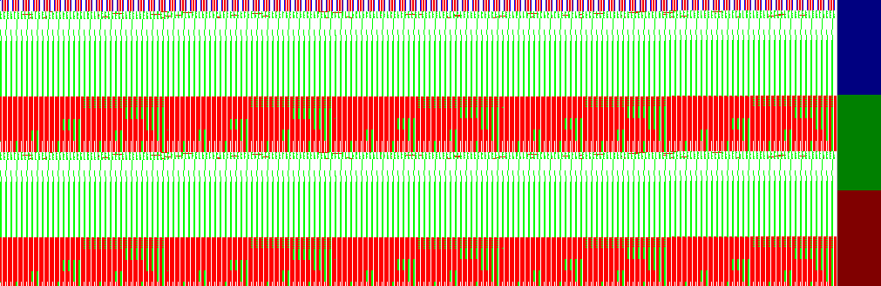
FFT
Notes:
In the fast Fourier transform, a lot of accesses with a large power of 2 stride are made. These lead to a lot of conflicts, as can be seen in the figure.

Slide 44
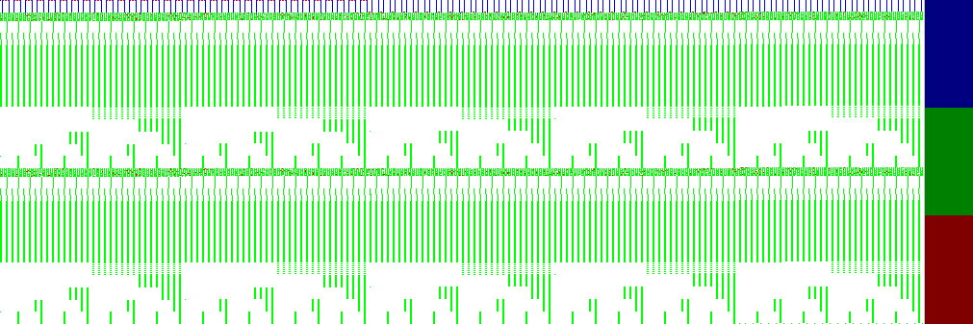
FFT: After array padding
Notes:
Here is the effect after array padding.

Slide 45
Pattern-based visualization:
Pattern-based visualization of the cache behavior on program execution guides the programmer to detect the bottleneck for cache optimization
Cache optimizing program transformations, such as loop tiling, array padding and data alignment, can be verified with the visualization
Notes:
Now let’s conclude the work. First, visualization of cache behavior on program execution guides the programmer to detect the bottleneck for cache optimization. Second, cache optimizing transformations can be verified with the visualization.

Slide 46
Cache Remapping to Improve the Performance of Tiled Algorithms
(Euro-Par 2000, J.UCS Oct. 2000)
Notes:
(Comments for the third part are copied from the comments originally given at the Euro-Par 2000 conference)
Good Morning,
My name is Kristof Beyls and in the next 20 minutes, I want to tell you about Cache Remapping and how it improves the performance of tiled algorithms

Slide 47
Overview Cache Remapping
Tiling
Cache remapping
  Concept
  Code transformation for EPIC
Evaluation
Summary
Notes:
I’ll discuss the tiling loop transformation, which improves the data locality and the memory performance
of loop nests.
After tiling is introduced, I’ll explain the concept of cache remapping. I’ll also discuss the program transformations needed
to implement cache remapping on an EPIC processor.
Further on, the proposed technique will be evaluated by comparing cache remapped version of the tiled matrix multiplication with other known techniques to improve the performance of the tiled matrix multiplication.
I’ll finish with the conclusion.

Slide 48
Overview Cache Remapping
Tiling
Cache remapping
  Concept
  Code transformation for EPIC
Evaluation
Summary
Notes:
To improve the cache performance of array-based loop kernels, tiling has been proposed.

Slide 49
Loop Tiling
Matrix Multiplication
for i:=1 to N do
for k:=1 to N do
for j:=1 to N do
C[i,j]+=A[i,k]*B[k,j];
If cache size < N*N,
no temporal reuse
for ii:=1 to N by B1 do
for kk:=1 to N by B2 do
for jj:=1 to N by B3 do
for i:=ii to min(ii+B1-1,N) do
for k:=kk to min(kk+B2-1,N) do
for j:=jj to min(jj+B3-1,N) do
C[i,j]=A[i,k]*B[k,j];
Ti
Td
Possible Cache reuse if
cache size >= B2*B3
Notes:
After tiling, the loop will iterate over blocks, resulting in a smaller number of references between the use and reuse of array elements. Because of the increased temporal locality, the hit rate of the cache increases, together with the performance.

Slide 50
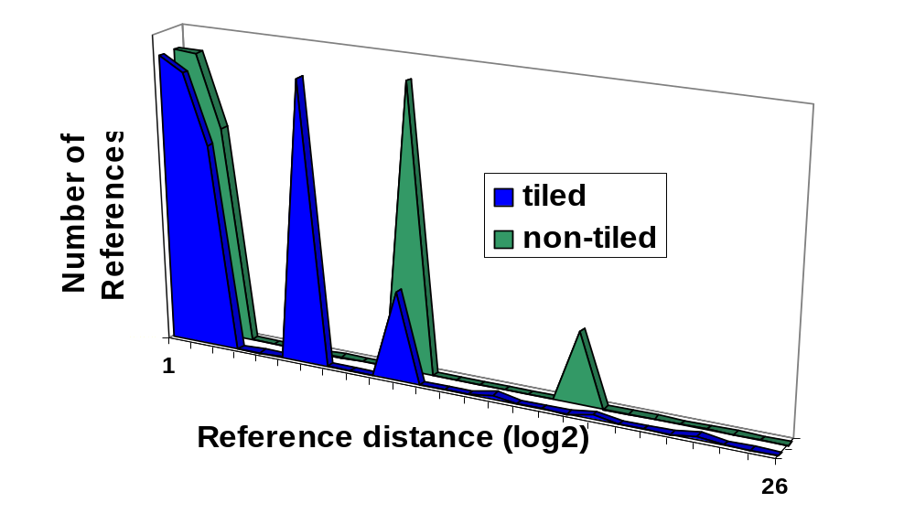
Tiling Reduces Capacity Misses
Tiling reduces capacity misses by shortening the reuse distances
Notes:
The inner loops of a tiled loop nest iterate over a smaller portion of the data, and reuses data earlier than in the complete matrix multiplication. As a result the number of references between reuses of the same data is smaller. The chance of finding the reused data in the cache is bigger when less elements have been referenced since the previous use. The shortened reuse distances reduce the capacity misses.

Slide 51
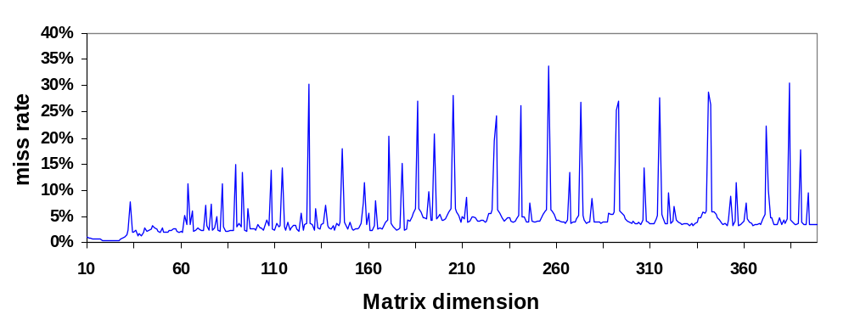
Tiling is not a Panacea
Capacity misses are reduced,
cold en conflict misses stay.
Conflict misses depend strongly on matrix
dimension
Notes:
However, tiling is not a panacea. Capacity misses are reduced because of the shortened reuse distances. However, in low-associative caches, a great number of conflict misses can remain. The number of conflict misses is strongly dependent on the array dimensions. In the plot, the miss ratio of the matrix multiplication of dimensions between 10 and 400 for a 16Kb direct mapped cache is plotted. The peaks in the plot are caused by conflict misses.

Slide 52
Overview Cache Remapping
Tiling
Cache remapping
  Concept
  Code transformation for EPIC
Evaluation
Summary
Notes:
To eliminate the conflict misses, cache remapping can be used. I’ll first explain the concept of cache remapping.

Slide 53
Threaded Pipeline
Computation thread performs the calculations
Remap thread places data used by computation
thread in the cache. After the data has been
processed, it is copied back to the memory.
Remap thread
Computation thread
Remap thread
time
Notes:
Conceptually, the functionality of the program is split into 2 threads, the computation thread and the remap thread.
The remap thread transfers data between the cache and the memory, the computation thread performs all the calculations. The computation thread will never experience cache misses, because the remap thread fetches data that is soon to be used by the computation thread and puts it in the cache.
The remap thread will first fetch a data tile and store it in the cache. In the next step, the computation thread will process the tile, while the remap thread fetches the next data tile. Another step later, the remap thread copies the data which was written by the computation thread into the memory, thereby freeing cache memory. In the freed cache memory, the remap thread fetches the next data tile.

Slide 54




Cache Remapping
Computation thread
Remap thread
Processor
P₁: scalars
P₂: current tile
P₃: future tile
P₁
Cache
P₂
P₃
Main
Memory
Notes:
The computation thread processes the current tile. At the same time the remap thread fetches the next tile form main memory. To resolve conflicts between the two threads, the cache is partitioned into 3 partitions: P1, P2 and P3. P2 holds the current tile. Cache partition P3 contains the tile which will be processed next by the computation thread. Cache partition is a small part of the cache which keeps the scalar variables in the loop kernel, which don’t fit into the register file.
After the next synchronization, the computation thread will process the data in the blue cache partition (3), and the remap thread will fetch the next tile into the green cache partition (2).

Slide 55
Cache Shadow
Cache
Address Space
Processor
LD_C1
Cache Shadow
LD_C3_C3
Notes:
At the start of the program, a consecutive block of memory with the same size as the cache is allocated, which is called the cache shadow. There’s a one-to-one relation between the addresses in the cache shadow and the storage area in the cache. The partition P1, P2 and P3 are allocated in this cache shadow. To assure that the contents of the cache shadow always resides in the cache, cache bypass is used. Every reference to an address outside the cache shadow will bypass the cache, for example by using cache hints. Every reference to an address in the cache shadow will be cached. Because there’s a one-to-one relation between the addresses in the cache shadow and the data areas in the cache, there are no internal cache conflicts in the cache shadow. No data from outside the cache shadow can enter the cache. Therefore, the data inside the cache shadow cannot be evicted from the cache.

Slide 56
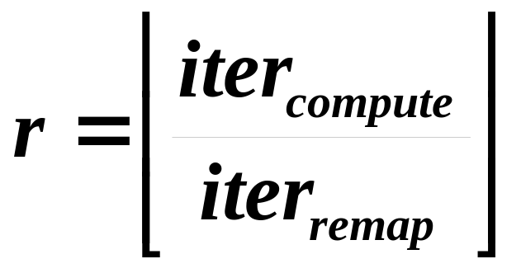
Tile Size Selection
Condition: 2 data tiles + scalars must fit in cache.
Many tile sizes qualify (B1,B2,B3)
  Choose the tile size for which
  is maximal.
  The choice shortens the remap thread w.r.t. the computation thread.
Notes:
To work efficiently, the remap thread should finish prefetching a data tile before the computation thread finishes processing a tile. The choice of the tile sizes influences the the relative time that both threads need to execute.
The condition that the data referenced during an iteration tile should fit in a cache partition must be satisfied. There are still a lot of tile sizes that fit into this condition. We choose the tile size so that the amount of computational work done during the remapping of a data element is as large as possible. This choice maximizes the factor r.

Slide 57
Processor Requirements
Cache bypass (e.g. cache hints).
Multiple instructions can be executed in parallel (e.g. superscalar processor).
Processor won’t stall on a main memory access (current superscalar processors stall: the instruction window is to small).
Notes:
The technique needs following processor properties to work:
Cache bypass must be possible to allow to fetch data from main memory without disturbing the cache.
Multiple independent instructions can be executed in parallel. This enables processing instructions from the computation thread and the remap thread at the same time, thereby diminishing the overhead of the remap thread.
The processor won’t stall on a main memory access. If the processor did stall on a main memory access, no useful computations could be performed during the fetch from the main memory.

Slide 58
Parallel Execution
On SMT processors not to difficult.
On EPIC processors possible via static thread scheduling:
  Many functional units, not all of them are used in every processor cycle.
  Instructions from the remap and computation thread can be executed in parallel.
  Instructions from both threads are interwoven by loop transformations.
Notes:
On Simultaneous Multithreaded Processors, the simultaneous execution of both threads is not to difficult. However, it is also possible to execute both threads in parallel on an EPIC processor. Because these explicitly parallel processors need their parallelism and the instruction level instead of the thread level, the thread must be threaded statically. This is feasible because of the regular structure of the loop kernels under consideration.
An efficient execution on EPIC processors is possible because they have many functional units, of which only few are used on every cycle. By scheduling the instructions of the remap thread in execution slots which are not grabbed by the computation thread, the overhead of the remap thread can be alleviated.
To bring the instructions from both threads together in the same cycle, the threads are interwoven by loop transformations.

Slide 59
Overview Cache Remapping
Tiling
Cache remapping
  Concept
  Code transformation for EPIC
Evaluation
Summary
Notes:
Now I’ll discuss the loop transformations which interweave both threads.

Slide 60
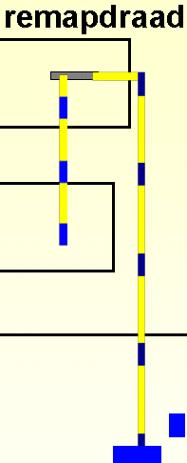
Remap Code
remap(double *x, double *y)
{
FLD_C3_C3 r1,y
FST_C1 x,r1
}
remapTileX(X,p,II,JJ)
{
for i1=1 to B1 do
for i2=1 to B2 do
remap(p+i1*B2+i2,
X[i1+II,i2+JJ]);
}
remapTileX(iter,X,p,II,JJ)
{
i1 = decoalesce1(iter);
i2 = decoalesce2(iter);
remap(p+i1*B2+i2,
X[i1+II,i2+JJ]);
}
Notes:
The code of the remap thread is built up as follows. The remap function copies data from address y to address x. The assembly code shown here is part of the PlayDoh-instruction set, the EPIC research architecture of HP. The first cache hint C3 in the LOAD instruction tells the processor that the data should not be brought higher than the third cache level in the memory hierarchy. The second C3 cache hint tells the instruction scheduler that it should assume that the data fetch will miss the cache, and assume main memory latency. The store with cache hint C1 tells that the processor that the data should be stored at address x and that it should be brought into cache level C1 if it is not already there.
The code to fetch data of an array accessed during an iteration tile consists of the code scanning each data point in the array, and remapping it into the cache partition.
To make interleaving possible, the loop are coalesced into a single loop, and the loop body is seen as a single piece of code.

Slide 61
Weaving Threads
swap(p2,p3);
iter=0;
for i = II to II+Q1 do
for j = JJ to JJ+B2-1 do
for k = KK to KK+B3-1 do
H(i,j,k,p2)
...
H(i,j,k+r-1,p2)
remapA(iter++,A,p3,II,KK)
Q1*B2*(B3/r) >= iterA
Unroll r times
iter=0
for i = II+Q1 to II+Q1+Q2 do
for j = JJ to JJ+B2-1 do
for k = KK to KK+B3-1 do
...
remapB(iter++,B,p3,KK,JJ)
Notes:
Here, the code of the code is shown which executes one iteration tile. At the beginning of the the processing of a tile, the roles of partition 2 and 3 are swapped.
The innermost loop in the original code is unrolled r times, after which a single data element is fetched from main memory and placed into the appropriate cache partition. As can be seen the computation thread work is performed on cache partition P2, the remapping on cache partition p3. The outermost loop of the tiled loops is exexuted just enough times to remap the array A completely. After the data tile for array A has been remapped, the computation thread continues working, and the code is transformed to remap a data element of array B every r computation iterations.
All function calls will be inlined, to let the instruction scheduler schedule the main memory accesses far enough from each other, and to fill the function units as good as possible.

Slide 62
Overview Cache Remapping
Tiling
Cache remapping
  Concept
  Code transformation for EPIC
Evaluation
Summary
Notes:
Lets go to the evaluation.

Slide 63
Compilation & Simulation
Trimaran contains an optimizing compiler + simulator for EPIC-architectures.
Compared with published techniques to alleviate conflicts misses in tiled algorithms.
Notes:
At the moment, no processor satisfies all requirement, in particular the requirement not to stall on a main memory access is not satisfied by almost all processors. Therefore we chose to simulate, using Trimaran, which is a research compiler and simulator for EPIC-architectures. We’ll compare the results with other techniques to alleviate the conflict misses in tiled algorithms.

Slide 64
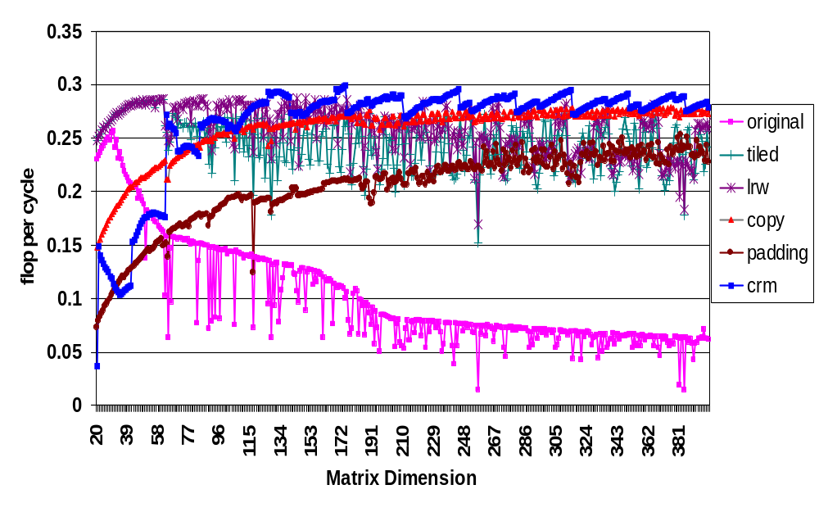
Results
Notes:
The simulated memory hierarchy was a 16Kb direct mapped L1 cache and a 256KB 4WSA L2 cache. A L1 miss takes 20 cycles, a main memory access takes 65 cycles.
In this plot, the number of floating point iterations per clock cycle is plotted for different matrix multiplications, for dimensions 20 to 400. The magenta? line at the bottom shows that the original (non-tiled) algorithm suffers a lot from cache misses. The other algorithms all are versions of the tiled matrix multiplication. The green line is the tiled version in which the tile size is chosen to fit in the cache. The brown line shows the performance of padding, which changes the matrix dimensions to a more favorable dimension by copying at the startup of the loop kernel. The purple line shows the result for the algorithm in which tile sizes were chosen to be small enough to avoid conflicts, according to the algorithm of Wolf and Lam. The red line shows the tiled algorithm with the copy optimization: before processing a tile, the tile is copied into a contiguous buffer, so that no conflicts occur. This is similar to cache remapping, except that cache remapping copies and prefetches in parallel. The blue line shows the results for cache remapping. To have a clearer look of the data, we zoom in to matrix dimensions 200 till 400.

Slide 65
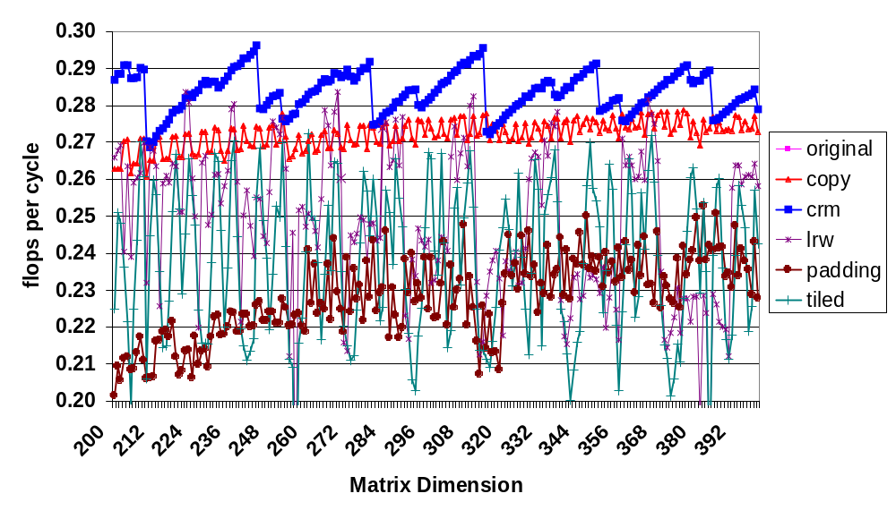
Results
Notes:
Here we see that cache remapping is at least as fast as other techniques. At best, it is 10% better than the next best technique. The saw-tooth pattern of cache remapping results from the fact that on the border of the matrix, the tiles are not completely filled. As a result of the pipelined computation, the smaller data tiles need as much processing time as the other data tiles, although the contain less work. To resolve this problem, we chose to only process completely filled tiles with cache remapping. The tiles at the border of the iteration space were processed by the copying technique. Nevertheless, the saw-tooth pattern still exists, because on some matrix dimensions, up to half of the tiles are not completely filled.

Slide 66
Overview Cache Remapping
Introduction
Tiling
Cache remapping
  Concept
  Code transformation for EPIC
Evaluation
Summary
Notes:
Now it’s time for the conclusion.

Slide 67
Summary
Cache remapping can remove all cache conflicts in tiled codes.
Preloading the data hides cold and capacity misses.
Implementation in a compiler and extension to more irregular codes is planned for the future.
Notes:
With the evaluation, it has been shown that cache remapping enables a faster execution of tiled algorithms.
In the future, we wish to implement the transformation into a compiler an evaluated this on a benchmark in which many loops can be tiled, such as the BLAS3 routines.
It would also be interesting to see what the effects of targeting L2 cache instead of L1 cache would be. Or prefetching from L2 cache instead of from main memory.
Also, we will work on the extension of the technique to more irregular and non-tiled programs.

Slide 68
Overall Conclusions
Reuse distances need to be shortened to reduce the capacity misses. It is best done at the compiler level.
Visualization allow to think about new program transformations to reduce capacity misses.
After capacity misses have been minimized, the conflict misses need to be removed. Cache remapping is a compile-time approach to do it.

Slide 69
The End
Time for questions

Slide 70
3. Visual pattern recognition
Study cache behavior patterns of simple programs:
simulated on a directed mapped cache with 1024 bytes cache size, 32 bytes line size.
3.1 Sequential accesses
  (a) in a single loop
  (b) in the outer loop
  (c) in the inner loop
3.2 Large stride accesses
  (a) One dimensional array
  (b) Two dimensional array
Notes:
Let’s examine the cache behavior patterns of several simple programs first. In this presentation, all experiments are done to a 1024 byte direct mapped cache with 32 byte cache lines.
First group of examples studies unit-stride sequential accesses to the memory, the second group shows what happens to a large-stride accesses.

Slide 71
3.1a Seq. accesses in single loop
double a[16384];
for (i=0; i<16384; i++)
a[i] = 1.0;
legend
Every 4 accesses to the 8-byte array elements, a compulsory miss occurs.
Notes:
Given this single loop over all elements of an array. The cache miss references are visualized in strips. Every four accesses have a compulsory miss. The bar of three colors is a legend to indicate the meaning of the pixels. Blue is compulsory, green capacity and red conflict.

Slide 72
3.1b Seq. accesses in outer loop
double a[16384];
for (i=0; i<16384; i++)
for (j=0; j<3; j++)
a[i] = 1.0;
A compulsory miss occurs every 4 distinct accesses to the 8-byte array elements, i.e.,
every 4*3=12 references in the program
Notes:
The second example uses a double loop. Each element is repeatedly accessed by j loop m times, except for the first access compulsory, the rest m-1 accesses hits.

Slide 73
3.1c Seq. accesses in inner loop
double a[16384];
for (i=0; i<4; i++)
for (j=0; j<16384; j++)
a[j] = 1.0;
A compulsory miss every 4 accesses in the first iteration of the outer loop. Then a capacity miss every 4 accesses in the remaining 3 iterations of the outer loop
Notes:
Interchange the two loops, one can see a different pattern. This is because the array elements are accessed after a long time that has been replaced in the cache, thus except for the first reference compulsory, the rest n-1 suffer capacity misses. Not all pixels are colored, because each cache line can hold four elements, thus 3 out of 4 references are already in the cache because of this spatial locality.

Slide 74
3.2a Large stride access 1D array
for (i=0; i<16384; i++)
a[i] = a[i+128];
Every reference is missed! A cold miss or a capacity miss occurs in average every 4 accesses, all the rest are conflict misses.
Notes:
The next example reveals conflict misses is the bottleneck for large stride accesses array that the two adjacent references belongs to different cache sets. Of course, this is a extreme case of conflict miss that every reference miss the cache.

Slide 75
3.2b Large stride access 2D array
  double a[128][128];
  for (i=0; i<128; i++)
  for (j=0; j<128; j++)
  a[i][j] = a[i+1][j];
The same pattern as the one-dimensional array large stride accesses. The unit-stride loop i gives large stride in the column-major order array.
Notes:
The same pattern can be found in double loop with two dimensional array. Here the loop stride or the array index stride is only one, but the mapped address has a large stride.

